Slide 1
BPC - PEDMATCH
Integration Overview

Slide 2
Terminology
Collection Grouping ID (“CGID”)
Shared by specimens of a given type taken from a patient in one encounter/surgery/etc.
Specimens sent to MATCHBOX will include the CGID
CGIDs will be “inherited” by the various aliquots/derivatives from the original specimens
Specimens obtained through follow-up requests by BPC (e.g., inadequate/insufficient received) will keep the original CGID if specimens are known to come from the same original encounter/surgery/block/etc.

Slide 3
“Specimen Received” Integration Message
DIRECTION: Outbound from BPC to MATCHBOX
TIMING: Sent when new specimens of interest are detected in STARS
Specimen is accessioned under APEC1621
Patient is enrolled in APEC1621
Specimen type of Blood or Tumor Tissue
Accessioning paperwork QC is successful
CONTENT:
Technical Message Headers (msg_guid, msg_dttm)
List of specimens
PED-MATCH attributes (patient_id, collection_grouping_id, type)
Additional (troubleshooting) attributes (stars_patient_id, stars_specimen_id, stars_specimen_type, received_ts, qc_ts)

Slide 4
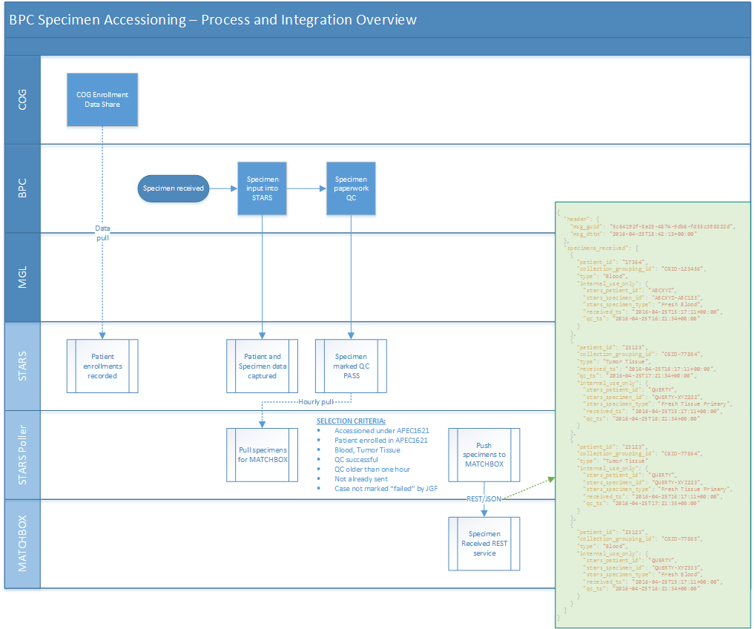
Scenario 1 – Successfully Received Specimens

Slide 7
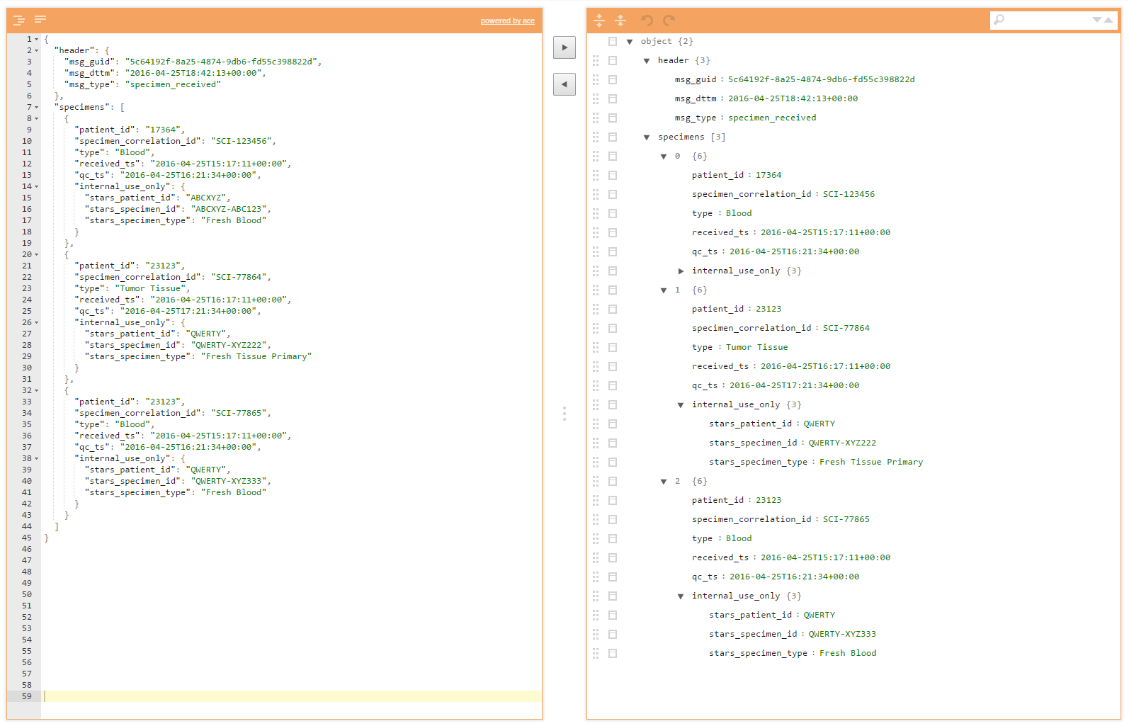
Sample REST Message BPC Specimen(s) Received
POST to Matchbox /specimens_received (conformant to a pre-defined JSON schema)

Slide 8
{
"header": {
"msg_guid": "5c64192f-8a25-4874-9db6-fd55c398822d",
"msg_dttm": "2016-04-25T18:42:13+00:00"
},
"specimens_received": [
{
"patient_id": "17364",
"specimen_correlation_id": "SCI-123456",
"type": "Blood",
"received_ts": "2016-04-25T15:17:11+00:00",
"qc_ts": "2016-04-25T16:21:34+00:00",
"internal_use_only": {
"stars_patient_id": "ABCXYZ",
"stars_specimen_id": "ABCXYZ-ABC123",
"stars_specimen_type": "Fresh Blood"
}
},
{
"patient_id": "23123",
"specimen_correlation_id": "SCI-77864",
"type": "Tumor Tissue",
"received_ts": "2016-04-25T16:17:11+00:00",
"qc_ts": "2016-04-25T17:21:34+00:00",
"internal_use_only": {
"stars_patient_id": "QWERTY",
"stars_specimen_id": "QWERTY-XYZ222",
"stars_specimen_type": "Fresh Tissue Primary"
}
},
{
"patient_id": "23123",
"specimen_correlation_id": "SCI-77864",
"type": "Tumor Tissue",
"received_ts": "2016-04-25T16:17:11+00:00",
"qc_ts": "2016-04-25T17:21:35+00:00",
"internal_use_only": {
"stars_patient_id": "QWERTY",
"stars_specimen_id": "QWERTY-XYZ223",
"stars_specimen_type": "Fresh Tissue Primary"
}
},
{
"patient_id": "23123",
"specimen_correlation_id": "SCI-77865",
"type": "Blood",
"received_ts": "2016-04-25T15:17:11+00:00",
"qc_ts": "2016-04-25T16:21:34+00:00",
"internal_use_only": {
"stars_patient_id": "QWERTY",
"stars_specimen_id": "QWERTY-XYZ333",
"stars_specimen_type": "Fresh Blood"
}
}
]
}
http://jsonschema.net/#/
http://www.jsoneditoronline.org/?id=9fb0089f64ae91d48b37ba62639dce07

